Slide 1
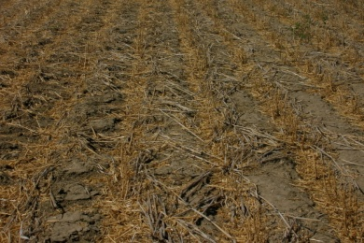
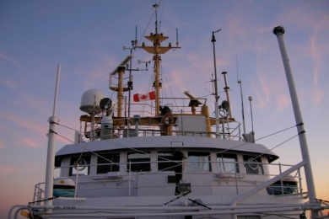
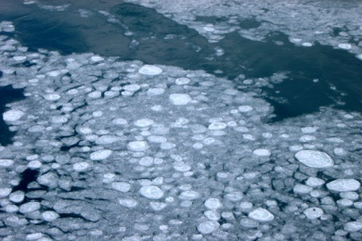
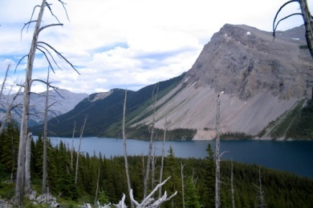
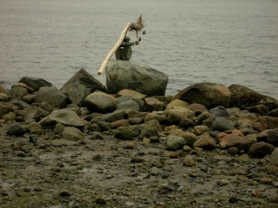

Slide 2
Sharing of experiences and knowledge in CC adaptation in water resources
Focus on practical tools, applied science, policy, participatory methods & case studies

Slide 3
Design and review of a National Compendium & Summary Report on the State of Practice of Water Adaptation in Canada.
Strengths, Opportunities and Recommendations

Slide 4
Harris Switzman
hswitzman@trca.on.ca
March 22 & 23
Toronto, Ontario
More details to follow

