Slide 1
PRAC: Drought and Excessive Moisture Theme
Adaptation to Climate Change on the
Canadian Prairies
February 15, 2012
Regina, SK

Slide 2
Alberta

Slide 3
Drought and Excessive Moisture: Alberta Ag and Rural Development
AB Drought Risk Management Plan (ADRMP)
Drought and Excessive Moisture Advisory Group (DEMAG)
Monitoring: Weather Station Network
Programming:
  Peace River Water Hauling Infrastructure Program (PRWHIP)
  Water Pumping Program
  Water Management Program
  Long term water supply
  Crop Development
Notes:
Additional Projects within ARD budget and business plan not PRAC funded.
AB Drought Risk Management Plan
- Targets: Capacity building, outreach and knowledge extension
- Including excessive moisture in a solid drought plan seemed to make sense because similar risk management tools are needed; however, creating a cohesive document to address both is proving to present some challenges. Separate chapter that focus on drought and excessive moisture may be needed in addition to combined section for risk management strategies/tools for both
- Communication plan is drafted
- Targets: Capacity building, Coordination and management
- Timing of releases a challenge
- Intention to do this once ADRMP is updated to include Excessive Moisture
DEMAG
- Stakeholder dialogue, Coordination and management.
- Purpose of the DEMAG is to provide recommendations to ARD DM that are strongly supported by industry
- Including industry stakeholder groups and several levels of government strengthens recommendations.
Peace River Water Hauling Infrastructure Program (PRWHIP)
- To provide funding for the development of water hauling infrastructure for municipalities to improve rural residents access to water and reduce time required to haul water
- Targets: Risk and vulnerability assessment (prioritizing adaptive responses)
Weather Stations/Data
- ARD continues to collect robust data from a network of weather stations that can be used for reporting, program delivery (AFSC), and planning for a variety of conditions.
Additional Weather Stations
- Plan for an additional 50 weather stations
Lack of available funding creating an obstacle to expansion
Water Pumping Program
Program policy reviewed and adjusted to respond to extreme weather events
Water Management Program
- Addresses drought preparedness
- Growing Forward program delivered by ARD water specialists
Long term water supply
- ARD Team developing long-term water supply options
- 25 year strategic water plan being developed with 5 and 10 year goals
Crop Development
- On-going development work on crop drought resistance

Slide 4
ARD Progress on Adaptation
ARD has:
  Established a near real time Ag weather station network
  Implemented a state of the art quality control program
  Established a provincial drought and excessive moisture monitoring model which forms the basis for addressing agricultural risk management related adaptation issues in the province and beyond

Slide 5
Versatile Soil Moisture Budget
Two part project:
Performance Evaluation of Versatile Soil Moisture Budget (VSMB) Model Components (-energy and soil water balance during the growing seasons)
Development and Implementation of Snow and Frozen Soil Algorithms in Versatile Soil Moisture Budget (VSMB) Model (snow accumulation and melt during the cold season)
Notes:
Monitoring and analyzing the surface energy balance and soil moisture data in a wheat/barley field during June-October 2011, and; -Analyzing the energy balance and soil moisture data collected in a barley field during the growing seasons of 2009 and 2010. The data will be used to validate and calibrate the crop coefficients and drying curves functions used in the existing VSMB
Soil profile survey on soils representing typical agricultural soil in Alberta and analyze them for soil water retention characteristics and saturated hydraulic conductivity. The results will be used to determine the VSMB model parameters, namely field capacity, wilting point, and soil diffusivity for different soil types.
Two agreements between the Saskatchewan Watershed Authority (SWA), Alberta Agriculture and Rural Development (ARD) and the University of Calgary to conduct field and Laboratory research aimed to enhance the provincial soil moisture, drought and excessive moisture monitoring and reporting.

Slide 6
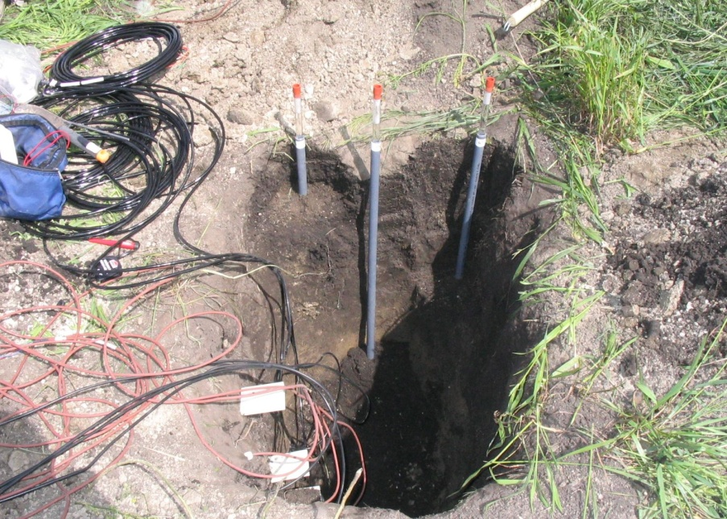
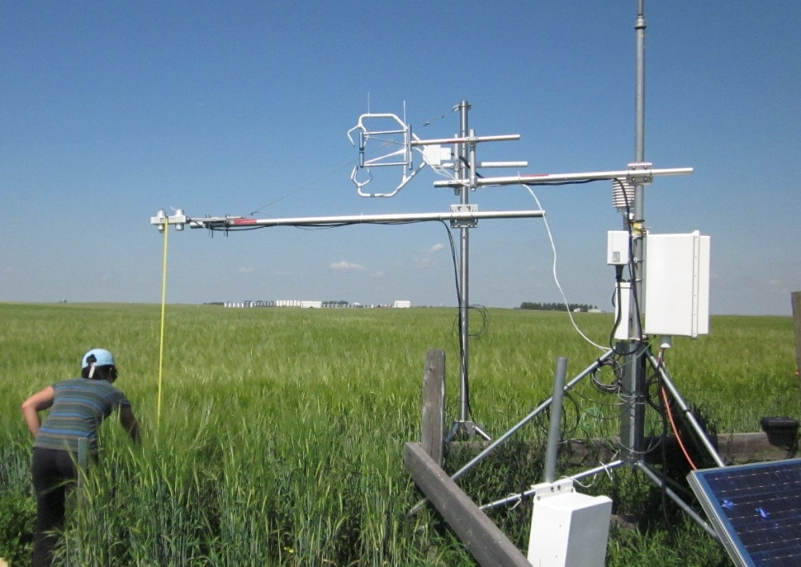
VSMB and Field Testing: Calgary Site
soil moisture sensors
precip.
evaporation
runoff
eddy-covariance system
groundwater recharge/discharge
Notes:
Real time full energy balance and soil profile moisture monitoring system was operational at Woolliams’ barley farm, 10 km north of Calgary.
The soil moisture and temperature sensors were installed in 2005. An eddy-covariance system for evaporation measurement was operational during April-October 2009 and June-October 2011

Slide 7
Observed data and VSMB model simulation: 2011
0-0.6 m zone
Notes:
-Versatile Soil Moisture Budget (VSMB) is a Canadian soil water balance model adopted by ARD.
-VSMB performance is being tested with data from the barley field and the above is the result from 2011.
E is actual evaporation and P is precipitation
-This year had an exceptionally large amount of rain in late May and June, causing the soil to become very moist. Evaporation during the relatively dry period of July and August is somewhat underestimated by VSMB. The VSMB also overestimate the soil moisture in the top 0.6 m. The cause of discrepancy needs to be investigated further.

Slide 8
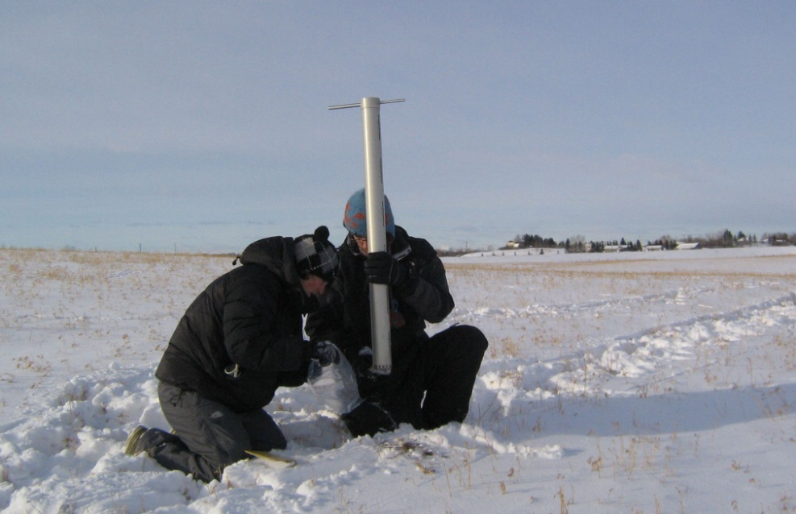
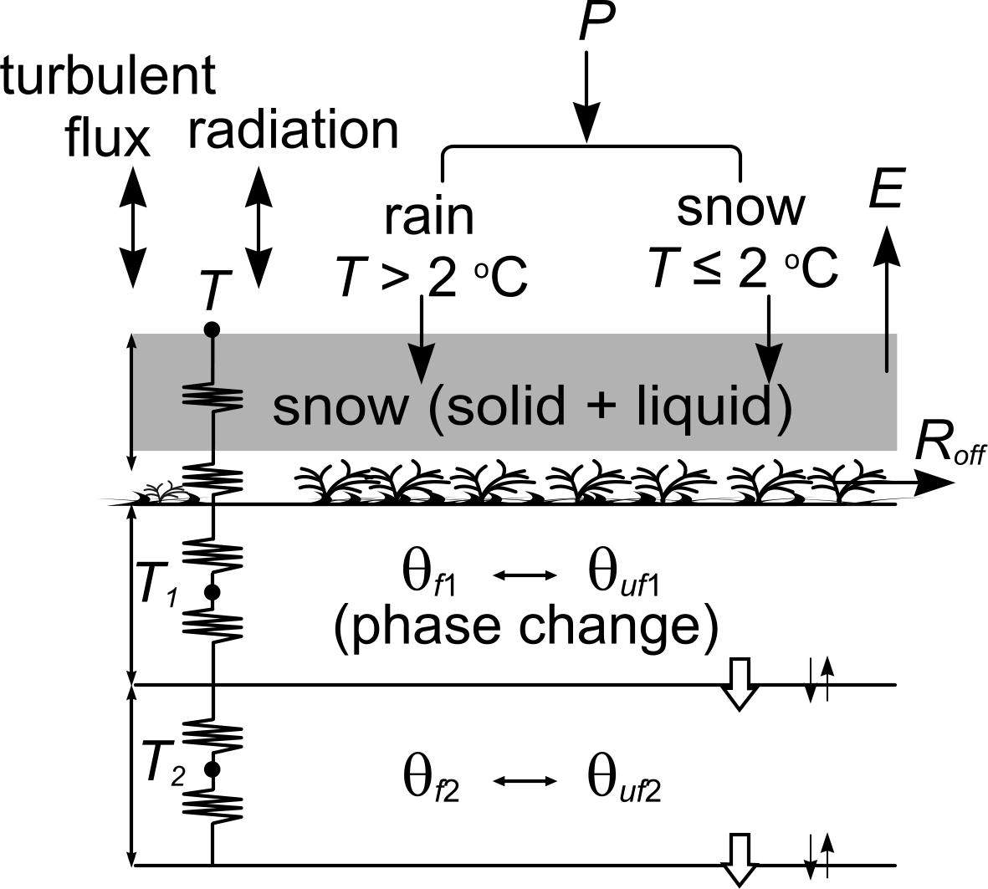
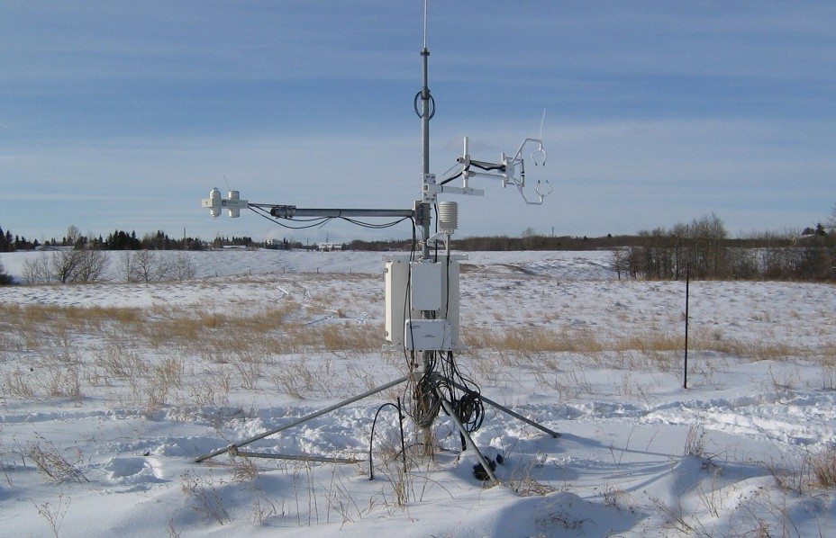
Improving Winter Processes in VSMB
snow survey
eddy-covariance system
Notes:
We are also modifying the VSMB to improve the representation of winter processes, including snow accumulation and melt, soil freezing and
thawing, and snowmelt infiltration and runoff.
-The new version of VSMB (called VSMBn in the next slide) explicitly models the snow energy balance and soil freezing and thawing. This requires
more data (e.g. hourly meteorological data including solar radiation), but these data are available from many of the ARD climate stations.
The model has been tested using the field data collected at the U of C Spy Hill Farm.

Slide 9
New VSMB Winter Testing:
Notes:
- These are the results from the winter of 2006-2007 field data. The top graph shows daily precipitation and daily mean air temperature.
The next shows vapour flux from the snow (or ground) surface. The VSMBn simulates the high sublimation rates during Chinook events
reasonably well.
- The next graph shows the snow water equivalent (SWE) obtained by conducting frequent snow survey on a 200-m transect. The VSMBn again simulates the evolution of snowpack reasonably well.

Slide 10
Notes:
-The top graph shows the observed and simulated soil temperature. The VSMBn predicts the date of thawing at 0.1 m and 0.6 m depth within
about five days of the actual date.
-The VSMBn tends to overestimate liquid water in the upper (0-0.4m) soil layer and underestimate in in the lower (0.4-1.2m) soil layer, but total
amount of water is reasonably well simulated by the VSMBn.
The VSMBn estimates the timing and amount of snowmelt runoff reasonably well. This is an important achievement, because snowmelt runoff
is the important source of water for wetlands and dugouts in the prairies.

Slide 11
Saskatchewan

Slide 12
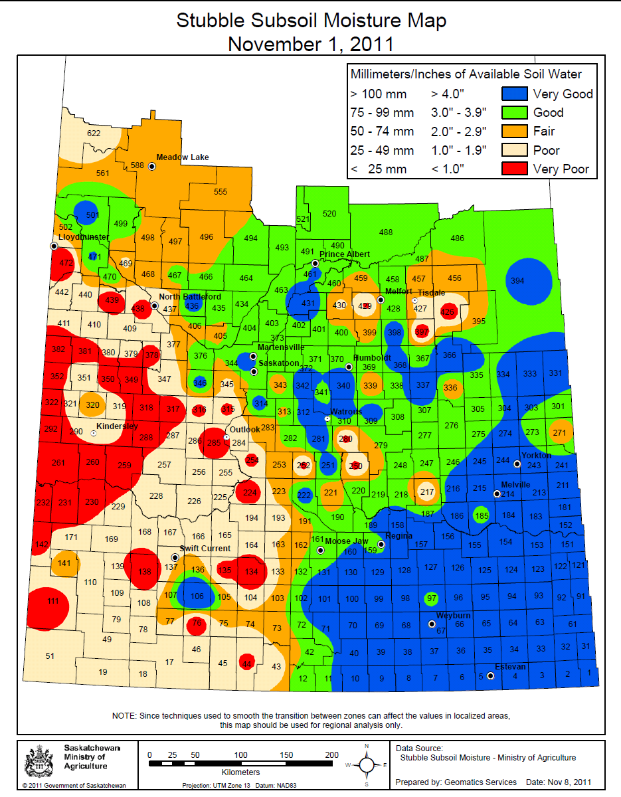
  Agricultural Drought and EM Monitoring Action Plan
Multiple agency committee
  MOA
  MOE
  SWA
  SCIC
  AAFC
    NAIS
    AESB
Notes:
NAIS (drought watch), community based monitoring, Regional reports, SCIC, SM monitoring, SRC. MOE (Forested areas), SWA (water and snow), Sat imagery monitoring
Several programs that may allow producers to become more prepared FSP, F&R, BRM
Program alterations and dates occurred quickly in response to weather conditions
Record Crop Insurance coverage and funding in the 2011-12 Agriculture budget will help protect Saskatchewan producers against risks such as excess moisture.
The Government of Saskatchewan has increased its Agriculture budget by $32 million to $418 million in 2011-12. More than three quarters of this year's budget will fully fund business risk management programs including Crop Insurance, AgriStability and AgriInvest.

Slide 13
Evaluation of DEM Monitoring in SK
Part I - Questions
  Review and describe strengths and weaknesses of drought and excessive moisture indicators and models
  Recommendations on which are most appropriate for SK
Results and Recommendations
  Drought: P-PET, deciles/percentiles and SPI
  Hydrological Conditions: Streamflow, reservoir and lake percentiles and SPI
Notes:
Contracted Steven Quiring with Texas A&M Dept of Geography
Part I - Research Questions
Review and describe strengths and weaknesses of drought and excessive moisture indicators and models
Recommendations on which are most appropriate for SK
Reviewed the following:
Palmer Drought Severity Index (PDSI) and Moisture Anomaly Index (Z)
Standardized Precipitation Index (SPI) and Standardized Precipitation/Evapotranspiration
Index (SPEI)
Vegetation Condition Index (VCI)
Vegetation Drought Response Index (VegDRI)
Stubble Subsoil Moisture
Variable Infiltration Capacity (VIC) (Soil Moisture Model)
Percent Normal and Precipitation Deciles
Precipitation (P) and Potential Evapotranspiration (PET)
Crop Reports
Palmer Hydrological Drought Index (PHDI)
Surface Water Supply Index (SWSI)
Streamflow, Lake and Reservoir Levels
Cold Regions Hydrological Model (CRHM)
Virtual Watersheds
Qualitative Analysis
Criterion Relative Importance
Robustness 30%
Tractability 25%
Transparency 15%
Sophistication 10%
Extendability 10%
Dimensionality 10%
Drought Monitoring Results – All three except for P-PET is currently available in SK
P-PET – Precipitation (P) and Potential Evapotranspiration (PET)
Utilizes potential evapotranspiration where many indices just look at precipitation
Deciles/percentiles
Percent normal is a simple method for comparing observed precipitation to normal precipitation for a particular location and time period. Observed precipitation is divided by normal (mean) precipitation (usually based on 30 years of data) and the result is expressed as a percentage.
Deciles are simple to calculate, but they require a relatively long record of precipitation.
SPI – Standaridized Precipitation Index
It is produced by standardizing the probability of observed precipitation for any duration. For example, durations of weeks or months can be used to apply this index for agricultural or meteorological purposes, and longer durations of years can be used to apply this index to water supply and water management purposes
Hydrological Monitoring Conditions Results
Streamflow, Reservoir and lake percentiles and SPI are the indices/models recommended for SK
All are available in SK, however, streamflow, lake and reservoir levels are not being used to calculate percentiles.
Overall, no single index can represent all aspects of agricultural/meteorological or hydrological/water supply drought so it is best to use a multi-index approach for operational monitoring of moisture conditions.

Slide 14
Evaluation of DEM Monitoring in SK
Part II – Questions
  Review existing observation networks (ID inadequacies). Review existing interpolation techniques
  Recommendations to improve monitoring in SK
Results and Recommendations
  Not enough stations (outside of growing season)
  Lack of integration and consistency of existing networks
  Develop a “network of networks”
Notes:
Part II – Research Questions
Review existing observation networks (ID inadequacies). Review existing interpolation techniques
Recommendations to improve monitoring in SK
Reviewed Observation Networks
Environment Canada
138 stations – described as a “network in crisis”
Issues with maintenance, number of stations has been declining
Saskatchewan Crop Insurance
131 stations since 2001
provides high quality measurements of temperature and precipitation
main limitation of the SCIC network in terms of monitoring drought and excessive moisture conditions is that data are not available in near-real time
only measure temperature and precipitation conditions during the growing season
WeatherFarm (Canadian Wheat Board)
Approximately 318 stations and expanding since 2007
main limitation of the WeatherFarm network is that the sensors are of lower quality than Environment Canada and SCIC
likely that these sensors will not last as long and will require more maintenance and repair than SCIC and Environment Canada equipment
other limitation stations are not sited following World Meteorological Organization standards or best practices
final concern – long-term viability
Ministry of Agriculture Volunteer Crop Reporters
volunteer crop reporter network measures precipitation during the growing season at >200 locations across the province
measurements are extremely valuable because they provide precipitation data at a large number of locations and they have good spatial coverage of the agricultural region of the province
major limitation of this network is that the data are not reported in real-time and observations are only collected during the growing season
Summary
Not enough stations (outside of growing season)
The number of weather stations and their spatial distribution has a major impact on accuracy.
To generate accurate maps of moisture conditions for Saskatchewan, it is necessary to utilize a large number of weather stations that are spaced such that they are spatially representative and can capture the true nature of variations in moisture conditions across the province.
Lack of integration and consistency of existing networks
Recommendations
Province of Saskatchewan should reduce its reliance on the Environment Canada network and focus on increasing the usage of other weather networks.
Develop network of networks – increase integration of available observation networks
Combining all four networks would significantly improve the ability to resolve finer spatial details in moisture conditions
Require a network of at least 500 stations
Interpolation techniques
Inverse Distance Weighting IDW most appropriate method for interpolation precip in SK
IDW is a nearest-neighbour weighted interpolator

Slide 15
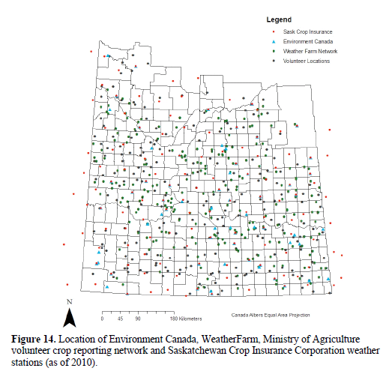
Network of Networks
Notes:
there are somewhat less than 800 stations in Saskatchewan because of the overlap in station locations between the four networks

Slide 16
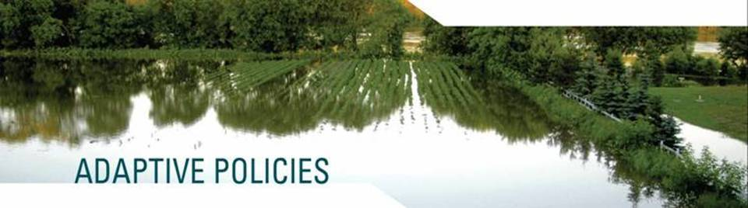
Adaptive Policy Assessment Tool
Is the suite of policies/programmes capable of supporting anticipated climate change adaptation actions?
Is the suite of policies/programmes adaptive in and of themselves?

Slide 17
Seven Tools for Creating Adaptive Policies
Integrated and forward-looking analysis
Multi-stakeholder deliberation
Built-in policy adjustment
Formal policy review
Promoting variation
Enabling self-organization
Decentralization of decision-making
Planned Adaptability (to anticipated conditions)
Autonomous Adaptability
(for unanticipated conditions)

Slide 18
  Adaptive Policy Evaluation Tool
NAWMP Pilot
Criteria (Green=Contributing; Yellow=Marginal Contribution; Red=Not Contributing) | Ranking
 | NAWMP
Programs Ability to Support Anticipated Adaptation Needs (Planned Adaptability)
a) Are the identified adaptation actions supported by the existing suite of preparedness programs? What gaps exist? | Contributes to 25% of identified adaptation actions
b) Can the DEM Preparedness Programs cope with an increased range of expected climate conditions?
c) Does the existing suite of programs enhance the capacity of actors within each sector to adapt?
Programs Ability to Enable Sector Responses to Unanticipated Events (Autonomous Adaptability)
d) Enables Self-Organization and Social Networking
e) Decision-making is Decentralized
f) Mix of Instruments Used Across all programmes | N/A
g) Formal Review Mechanism in Place
Overall Contribution to Adaptation Needs

Slide 19
Adaptive Policy Evaluation Tool
Multiple Program Evaluation in MB
Notes:
Evaluated five programs operating in the East Interlake Conservation District:
Environmental Farm Plans (EFP)
AgriInsurance
AgriStability
The Agri-Food Research and Development Initiative (ARDI)
Manitoba Sustainable Agriculture Practices Programme (MSAPP)

Slide 20
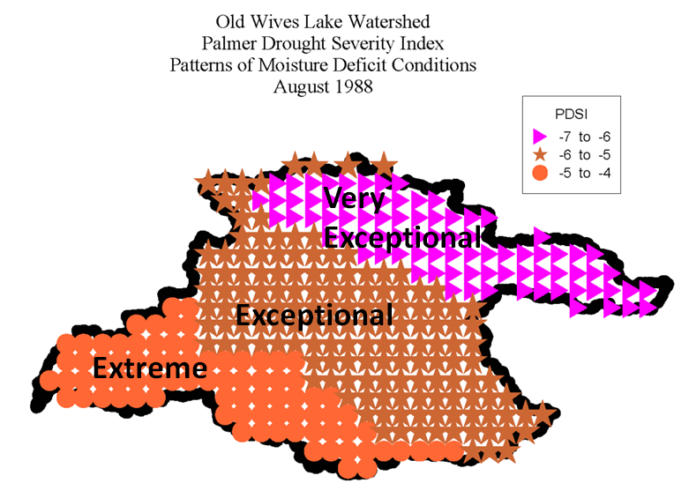
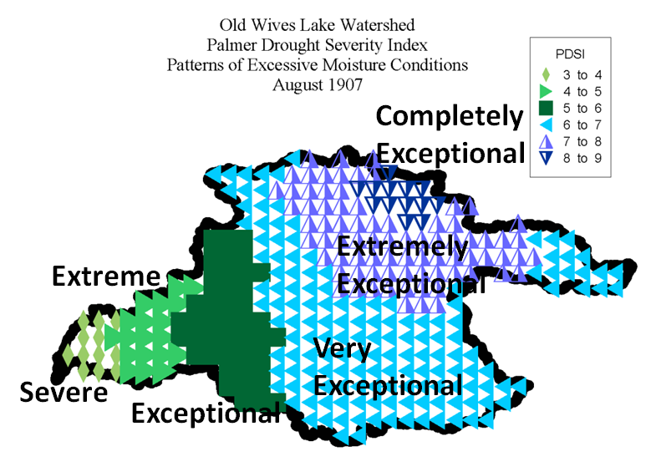
DEM Preparedness Planning: Old Wives Lake Watershed
Select Action Items:
Rural and Municipal Planning:
  Renew or establish local emergency response plans (ensure roles and responsibilities are understood)
Watershed Infrastructure:
  Identify locations of potential ice jams and monitor during thaw
Agriculture and Land Management:
  Dugouts should be designed to reduce evaporation (long, narrow deep)
Communication:
  more real-time data and better communication of available data
Wittrock, V. and Wheaton, E. 2011
Notes:
Partnered with local watershed stewardship agencies to deliver workshops
Workshops engaged local stakeholders and resource managers aiming to:
Provide direction on adaptation for local watershed stewardship groups; and
Develop recommendations for provincial policy that would facilitate local adaptation
Developed 5 preparedness plans to date
Swift Current Creek Watershed
Assiniboine/Yorkton Creek
North Saskatchewan River Watershed
Moose Jaw and Old Wives Lake – draft
Upper Souris – workshops completed

Slide 21
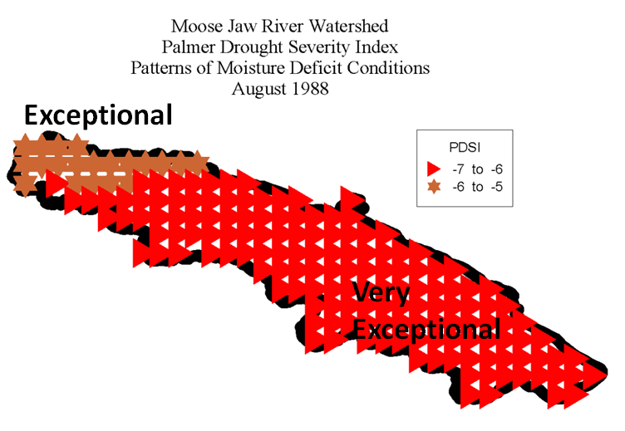
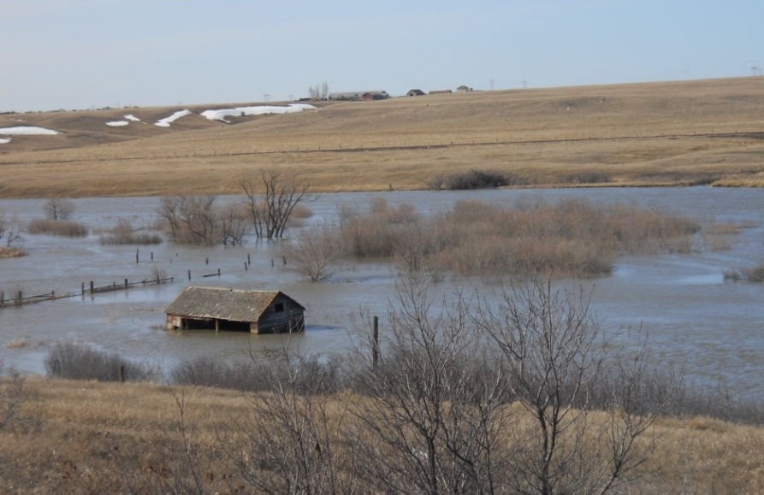
DEM Preparedness Planning: Moose Jaw River Watershed
Select Action Items:
Planning and Communication:
  Municipalities should ensure sand bags are on standby for anticipated flood events
Water Conservation Programming and Education:
  Municipalities should encouraged watershed residents to utilize rain barrels to reduce demand
Land Management:
  Municipalities should work with stewardship agencies to promote agricultural beneficial management practices that re-establish riparian areas and buffer strips
Wittrock, V. and Wheaton, E. 2011
Source: Moose Jaw River Watershed Stewards

Slide 22
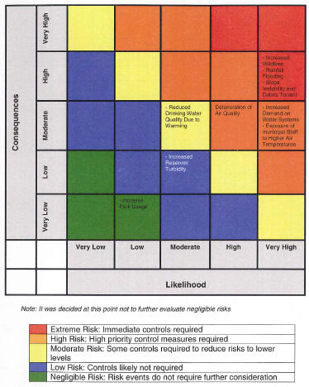
Climate Extremes Workshop
Workshop held February 8, 2012 in Regina, SK
Target audience municipal and provincial decision makers
“Train the trainer” event
Dave Sauchyn, PARC and Bob Black, Black Shield Preparedness Solutions Inc.
Delivered Adapting to Climate Change : A Guide for Municipalities
Step 4: Risk Evaluation Matrix
Source: Black Shield Preparedness Solutions Inc.
Notes:
Workshop delivered a 6 step risk management process for climate change adaptation

Slide 23
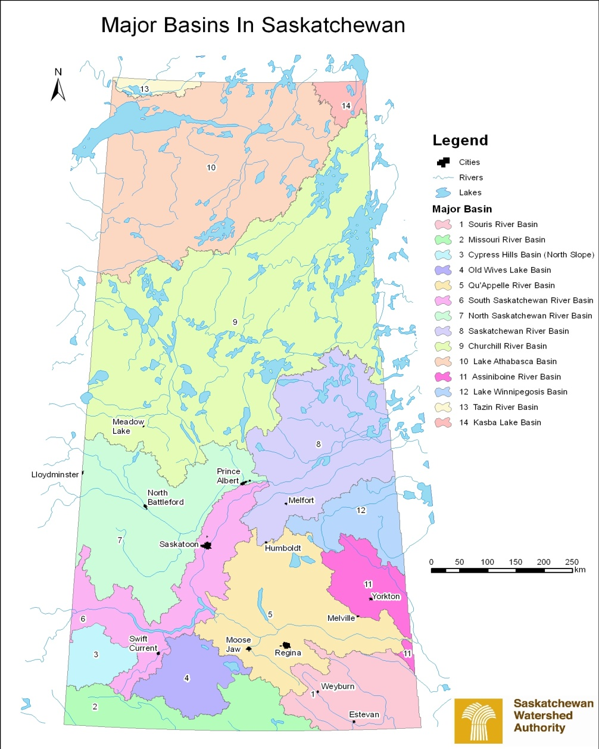
Water Demand
Water Demand
  Analyze water demand in Saskatchewan’s major drainage basins and provide projections for potential future demand based on various economic growth scenarios.
2010 established as baseline
Water demand projections for 2020, 2040 and 2060 for three separate scenarios
  Baseline
  Climate Change
  Adoption of Conservation Measures
Notes:
Scope
The study area encompasses the entire province of Saskatchewan and will be analyzed, evaluated and reported on according to the 14 major drainage basins in the province (Figure 1). The four northern major basins (Churchill River, Lake Athabasca, Tazin Lake and Kasba River) may be reported on collectively.
Analysis will include:
Assess current and future water demands from all key users, including industrial (oil and gas, mining, etc.), agricultural, municipal and other (wildlife, recreation).
Provide major drainage basin-specific analyses in addition to sector-specific analyses of water demands.
Projections of demand should be completed assuming supply will not be a limiting factor.

Slide 24
Water Demand Forecast: Qu’Appelle River Watershed

Slide 25
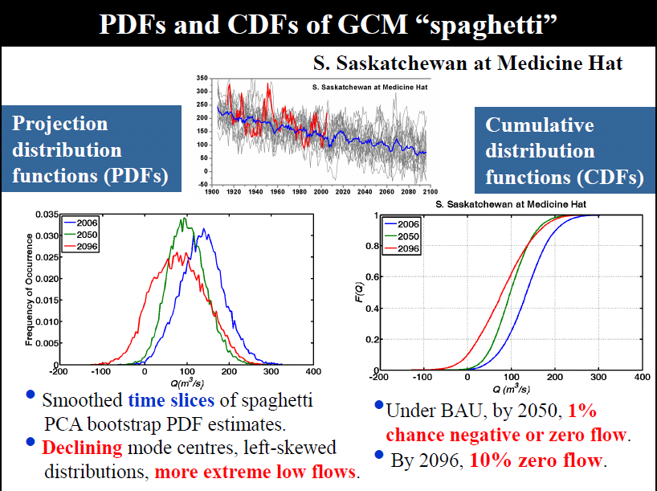

Slide 26
Mainstreaming Adaptation in Water Use Across Sectors in SK
Purpose:
  Engage sector stakeholders to incorporate beneficial water use practices across sectors
Focus groups were held with the following sectors:
  Irrigation;
  Urban municipalities; and
  Power generation.
Project Status:
  Focus groups are complete and draft reports submitted.
  Cost – Benefit Analysis underway
Notes:
Part one of a two part study
The purpose of this project is to engage key sector stakeholders in order to incorporate beneficial water use practices across sectors, giving water managers in Saskatchewan greater control of this resource and providing opportunities for adaptation to climate change and increasing environmental, economic and societal benefits.
Consultation is to include the following four sectors:
Irrigation;
Urban municipalities; and
Power generation.
Focus groups sessions will be held to assess vulnerability and risk of each sector to hydroclimatic change and variability.
Focus group sessions will focus on identifying potential adaptation options for the vulnerabilities and risks identified in the first session.
Based on the results of the focus group sessions, recommendations for policy options for each sector and recommendations on implementation will be described.
Part two will undertake a cost benefit analysis of the recommended policy options for each sector.

Slide 27
Preliminary Outcomes
Opportunities in the Irrigation Sector:
  Partner to promote irrigation scheduling and variable rate technologies
  Improve flood irrigation practices
  Programs to assist in lining ditches and converting ditches to pipes
  Research and development
Opportunities in the Municipal Sector:
  Integration of drought risk assessment and water conservation and efficiency planning into OCPs
  Water metering
  Enhanced education on water conservation and efficiency management techniques
  Identifying and targeting communities with the greatest vulnerabilities
Opportunities in the Power Generation Sector:
  Water reuse and recover
  Advanced cooling systems
  Improved ash disposal
  Carbon capture and storage alternative technologies

Slide 28
Manitoba

Slide 29
Manitoba Drought Management Plan
Purpose
  The plan will outline measures to mitigate drought effects and describe the recommended response to various
  The plan is intended to complement existing provincial water resources management and emergency plans and policies drought stages

Slide 30
Drought Response Action Plan and Strategies
Provides a protocols for communication, linkages and coordination among governmental agencies, committees and stakeholders for drought management
Provides drought mitigation and water conservation strategies
Provides a direction for updates, research and implementation

Slide 31
Drought Stages and Indicator
  Proposing four drought stages
Currently proposing several indicators to help define drought state including primary and secondary indicators.
Primary indicators would include precipitation and flow.
Secondary indicators would include groundwater and soil moisture
Notes:
Four possible drought stages:
Normal (green) stage - anticipate no water supply shortages
Moderate (blue) drought stage - indicates mild/modest drought and is the first indication of a potential water supply shortages
Severe (yellow) drought stage- severe/serious drought and potential serious water supply shortages
Extreme (red) drought stage - extreme/intense drought and major water supply shortages

Slide 32
Next Steps
Completion of an initial draft plan
Broader internal and external departmental and stakeholders review and engagement
Additional research on climate change and water supply and demand for major river basin Manitoba
Develop lake and reservoir drought indicators

Slide 33
Municipal Adaptive Planning Project
Working with City of Brandon and TransCanada West Planning District region of southwest Manitoba
2011 survey work done to identify current and future climate extreme risks (see charts)
November 2011 workshop held with local officials to assess current and future climate risks and test a municipal climate adaptation planning tool
Consultant hired to build upon fall 2011 workshop-continue using municipal planning tool
Notes:
Depending on the model the ranges for temperature increase changes. From a range of 1.1-2.9 degree increase to 2.4-6.4 degree increase

Slide 34
Summary of 2011 Web-Survey:
Current Vulnerabilities in Municipal MB
Figure : Most critical challenges identified in the surveyed communities (in %; no = 34)

Slide 35
Potential future climate change impacts (identified from survey respondents in TCWPD region) | Chosen by respondents (%)
More frequent and severe heat waves | 24
Less certainty of seasonal weather patterns (more variability and less predictability of seasonal weather) | 76
Increased frequency and severity of flooding and excess moisture episodes | 91
Increasing challenges in storm water management | 68
Changes in lake and river water levels | 62
Increased frequency and severity of drought | 15
Biodiversity and ecosystems shifts | 12
Greater risk for invasive species | 15
Altered transportation systems | 18
Impacts on energy generation and distribution | 15
Impacts on housing and buildings | 35

Slide 36
Municipal Adaptive Planning Project-cont.
Seek to integrate/align adaptive decision making to address current/future climate extreme risks (ie infra., excess moisture)
City of Winnipeg working on video awareness project with key decision makers-to help integrate adaptive decision making into capital planning—results expected in March

Slide 37
BC Municipal Planning Framework
SETTING THE CONTEXT
Final report end of March on lessons learned, recommended next steps
PRELIMINARY ANALYSIS
RISK ESTIMATION
RISK
EVALUATION
March 7th Brandon workshop planned to go through steps 2-5
ADAPTATION MEASURES OR RISK CONTROLS
IMPLEMENTATION AND MONITORING
Source: Adapting to Climate Change: A Risk Based Guide for Local Governments in British Columbia, Vol. 1. Black et al., 2010

Slide 38
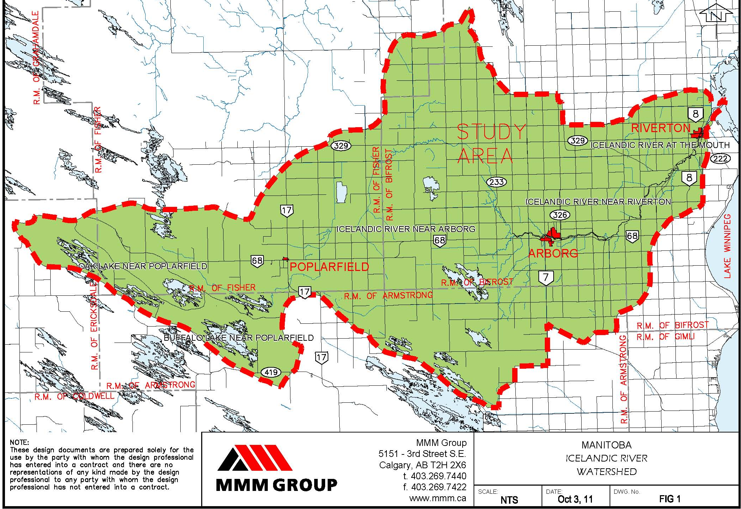
Provincial Planning on Adaptation for Excessive Moisture in the Interlake Region of Manitoba
Study Area: Icelandic River Watershed

Slide 39
Project Objectives
Evaluate risks from excess moisture on farmlands
Identify potential climate effects associated with modelling scenarios
Prepare recommendations to assist in development of a Provincial EM strategy
Notes:
The case study along with other PRAC projects will help inform the development of a larger provincial DEM strategy for Manitoba.

Slide 40
Consultation – Preliminary Findings
Weather Observations:
  Increased flooding and droughts
  Higher frequency of heavy rainfall events
  Changes in the length of seasons
Observed Effects:
  Loss of crop production
  Loss of prime agricultural land
  Changes to they types of crops grown
  Displaced wildlife

Slide 41
Consultation – Preliminary Findings
Local Adaptation Strategies
  Flood mitigation
  Water quality protection (seal abandoned wells)
  Riparian area fencing
  Restoration Projects: hay land, agricultural land, Wetland Restoration Incentive Program
Provincial and Federal Adaptation Strategies
  Financial help (e.g., agri-insurance, agri-recovery)

Slide 42
Additional Questions
Tom Harrison
Director, Partnerships and Plan Implementation
Saskatchewan Watershed Authority
111 Fairford St. East
Moose Jaw, SK S6H 7X9
e. Tom.Harrison@swa.ca
p. 306-536-2038

