Slide 1
Summary of Findings and Progress: Grasslands
Prairies Regional Adaptation Collaborative
Jeff Thorpe
Saskatchewan Research Council
February 15, 2012

Slide 2
Grassland work under the Prairies Regional Adaptation Collaborative
Two components:
How vulnerable are prairie grasslands to climate change?
What are the options for adapting to climate change?
Collaborators:
Manitoba
Manitoba Agriculture, Food and Rural Initiatives
Manitoba Conservation
Saskatchewan
Saskatchewan Watershed Authority
Saskatchewan Agriculture and Food
Saskatchewan Research Council
Alberta
Alberta Sustainable Resource Development

Slide 3
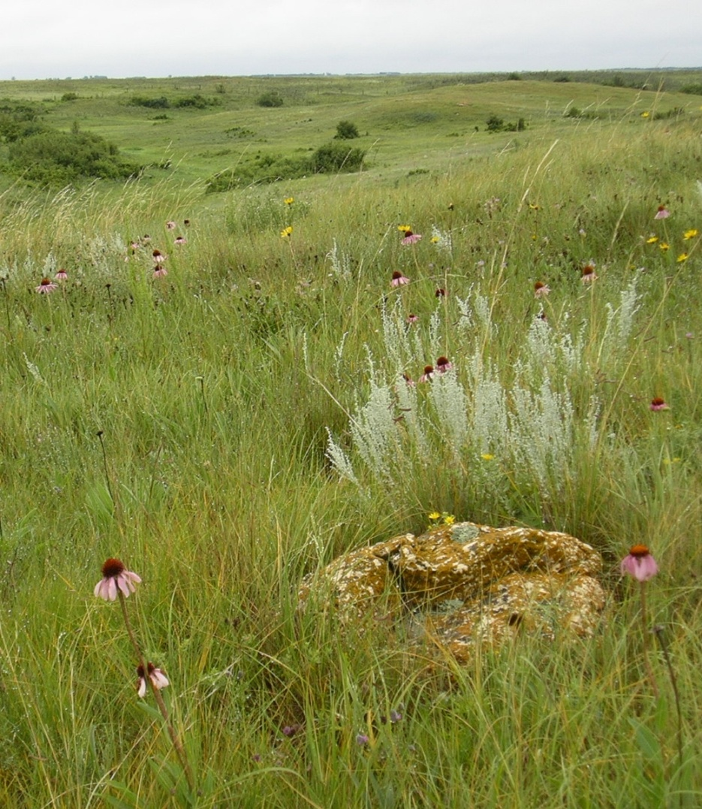
Native prairie
Created the rich soils that now support prairie agriculture.
Still makes up 20 - 25% of the Prairie Ecozone.
Provides a grazing resource for livestock producers.
Protects sensitive soils.
Supports biodiversity

Slide 4
Modeling of vegetation responses to climate change
Different types of grassland occur in different climatic regions.
A model was developed to predict the shift in grassland zonation with climate change
The model was calibrated using data from both Canada and the U.S. - using the U.S. Great Plains as an analogue for the future Canadian Prairies.

Slide 5
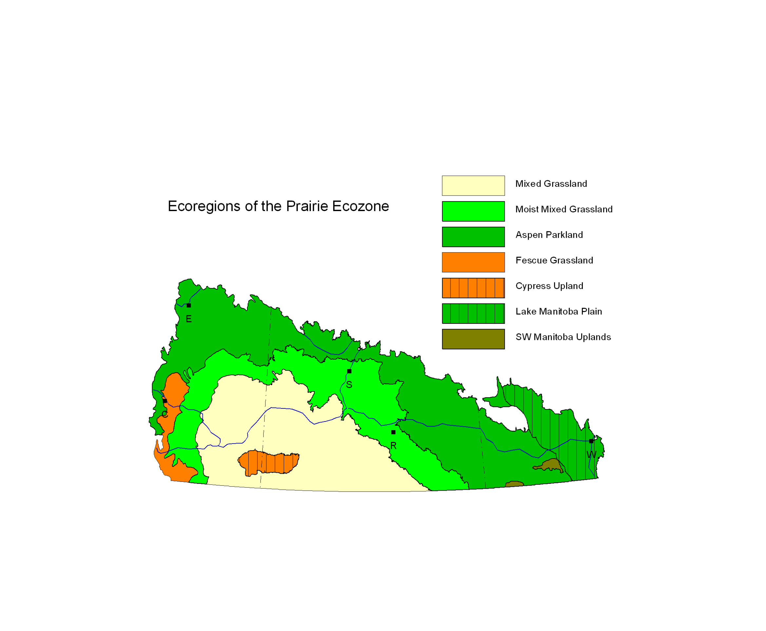

Slide 6
Kuchler vegetation types used for U.S. zonation

Slide 7
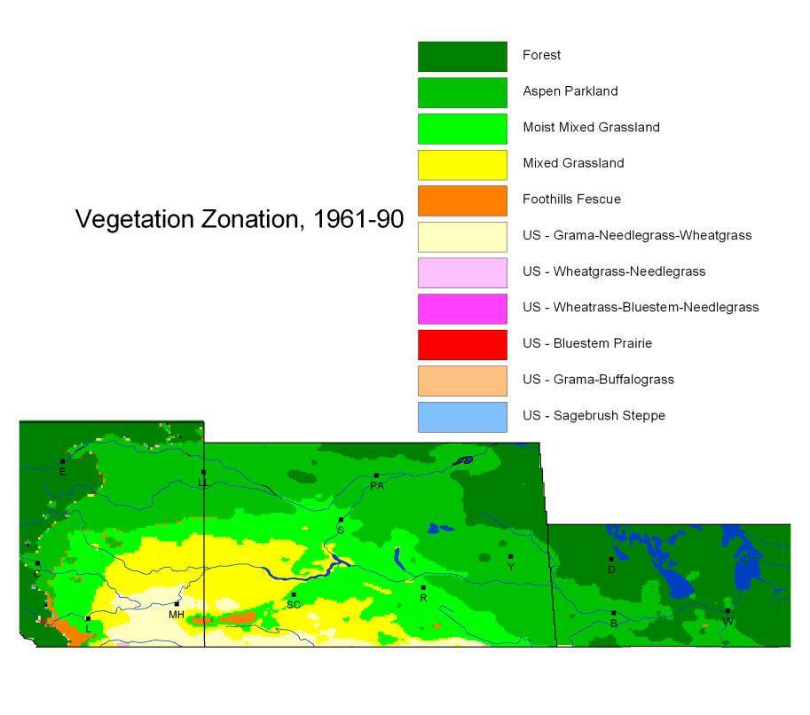

Slide 8
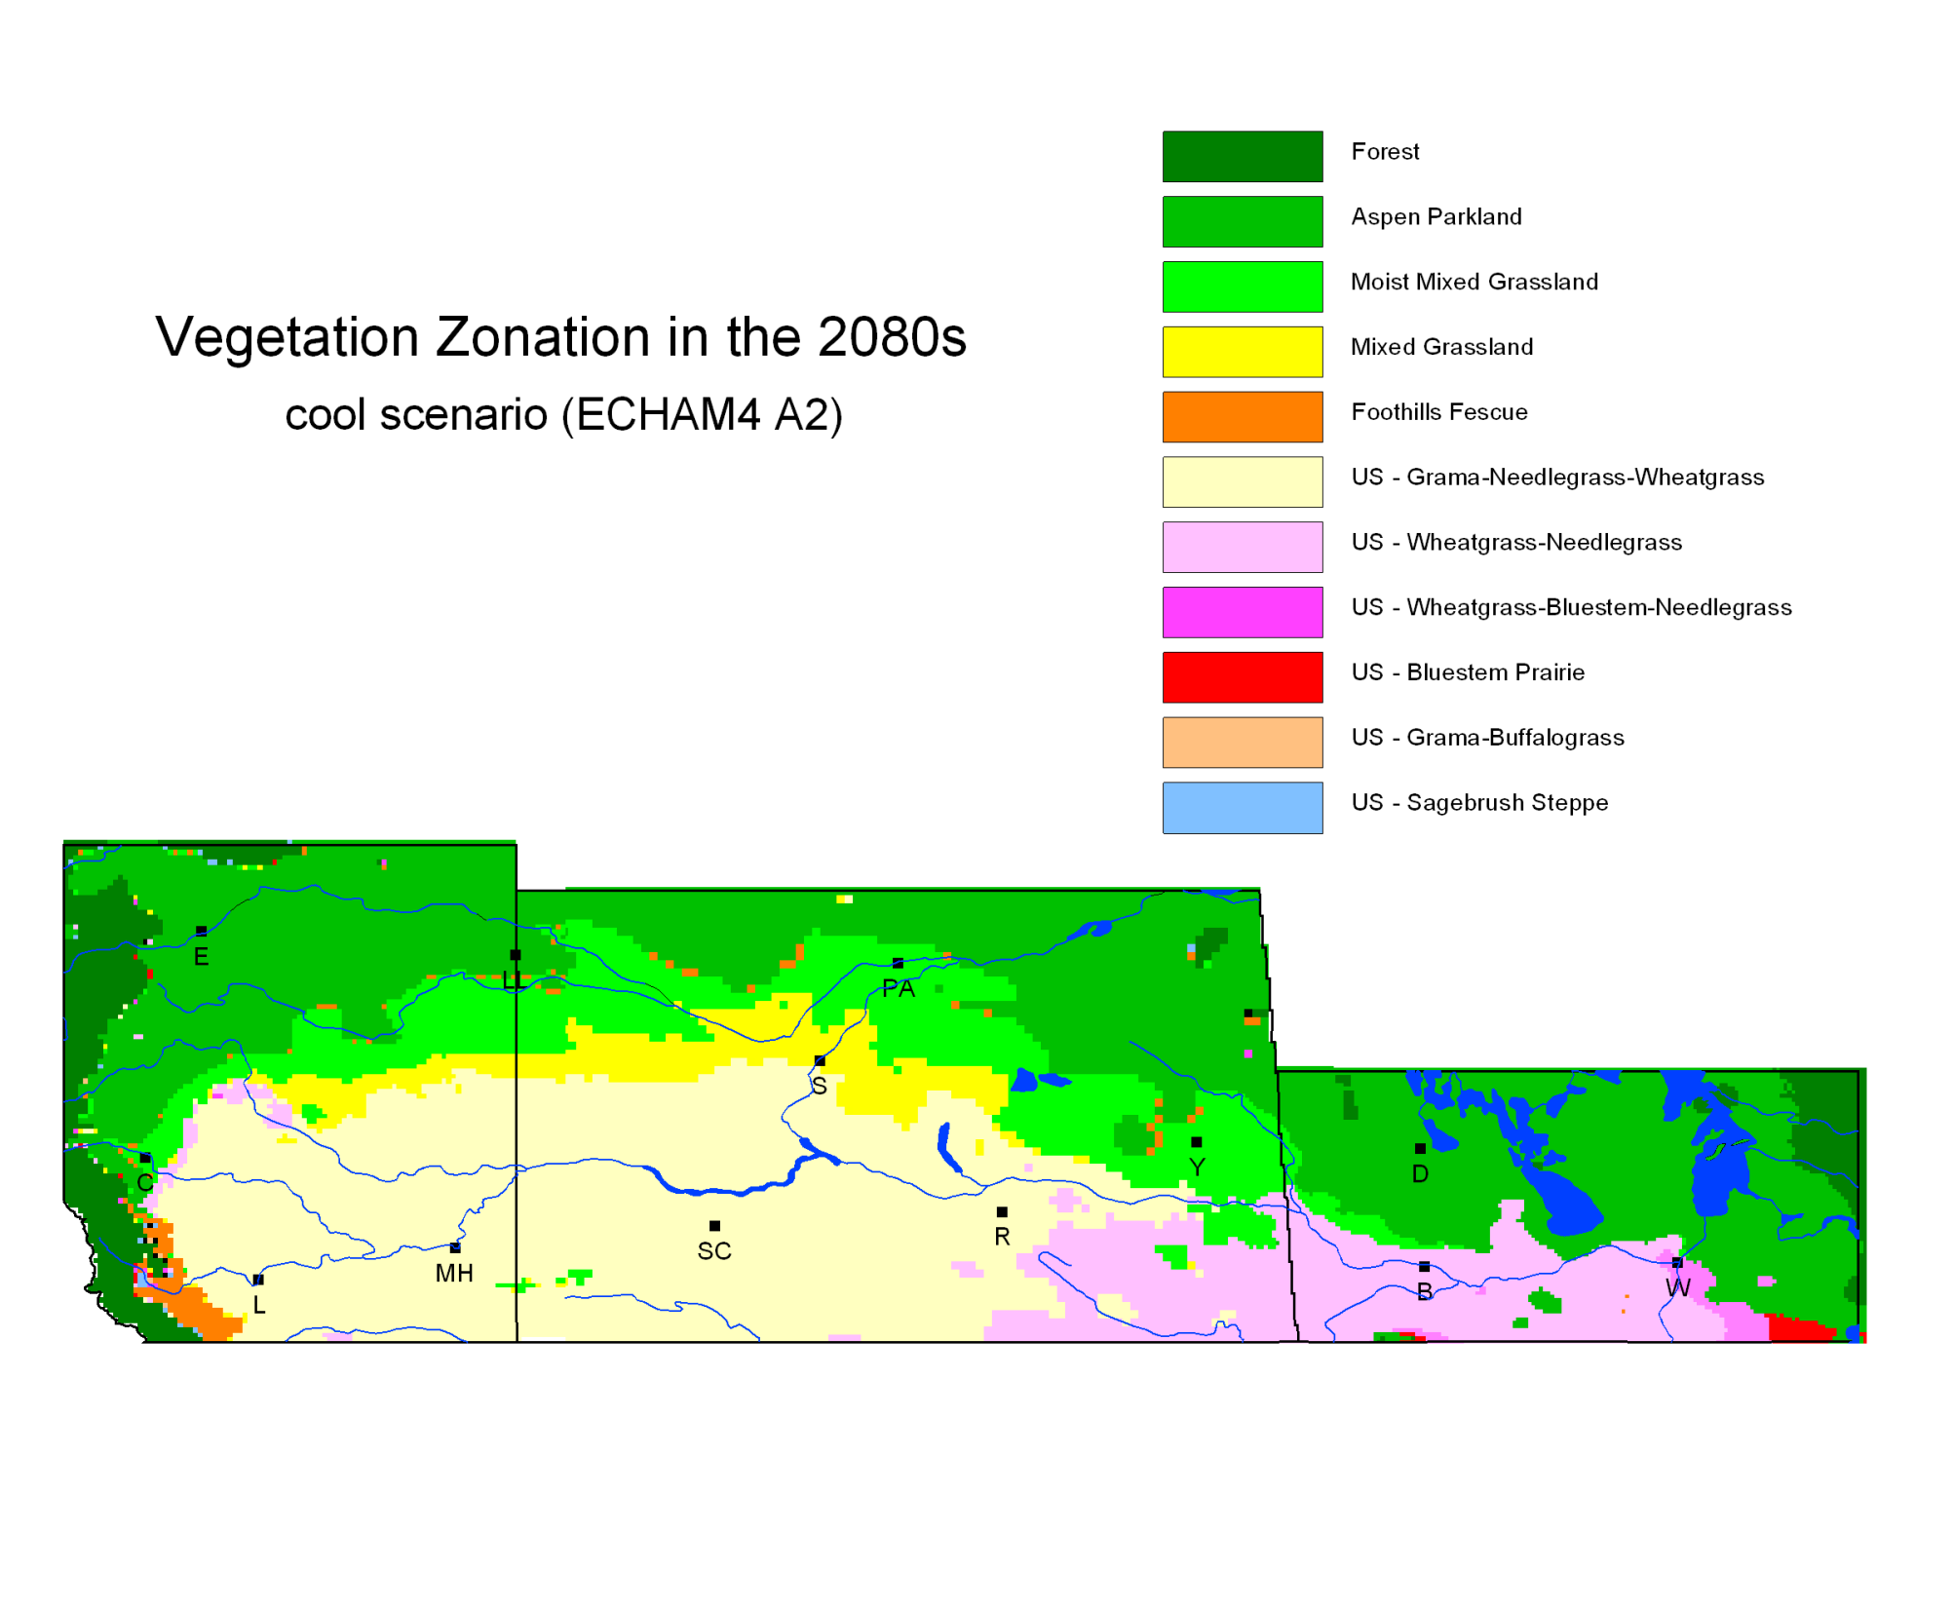

Slide 9
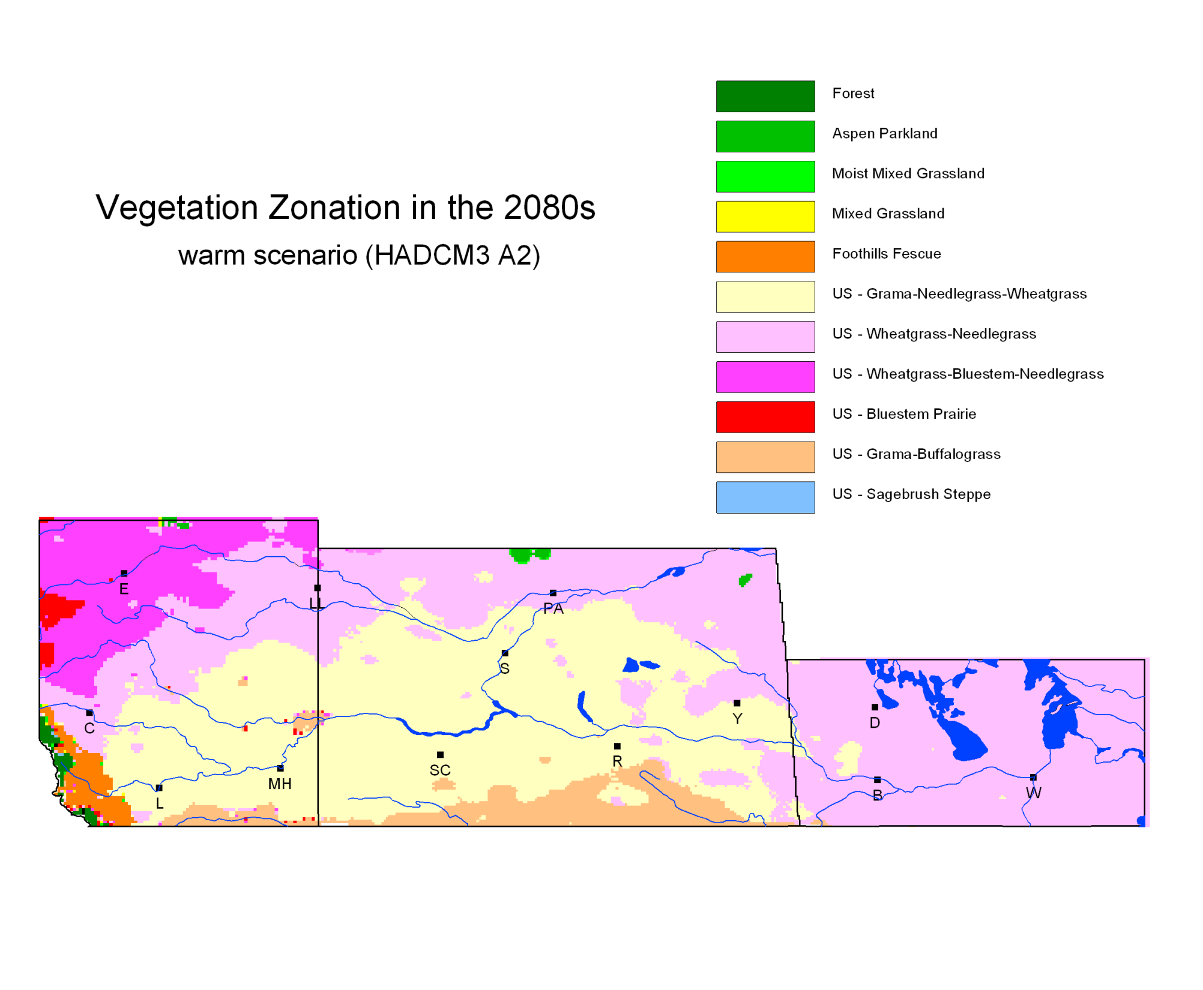

Slide 10
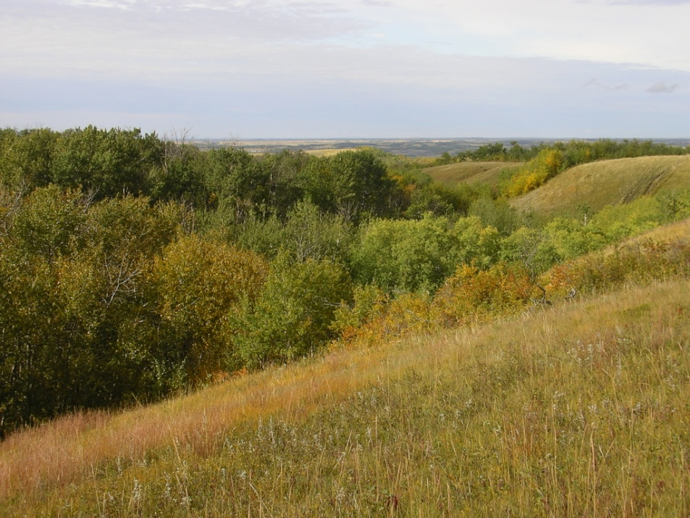
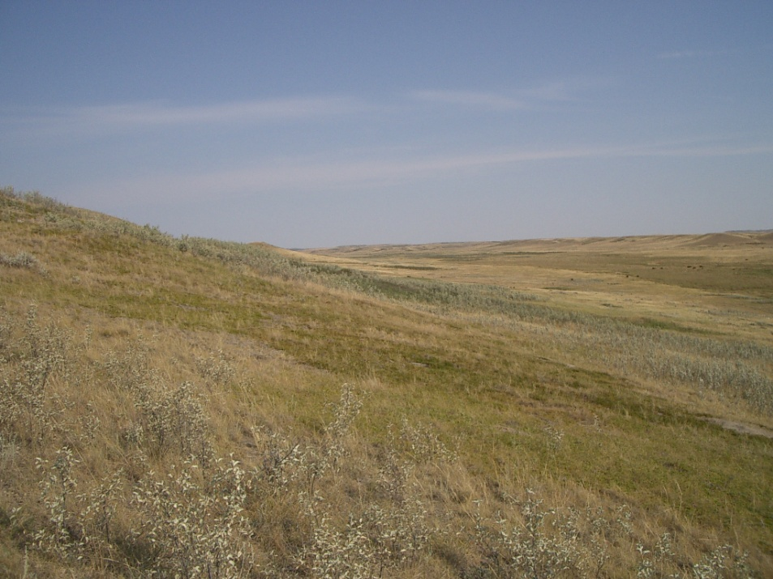
The zonation model is not an exact prediction, but it shows probable future trends:
gradual reduction in tree and tall shrub cover.
shifts in structure of grasslands from taller to shorter species.
decrease in cool-season grasses, increase in warm-season grasses.
gradual introduction of plant and animal species currently found only in the U.S.
↓

Slide 11
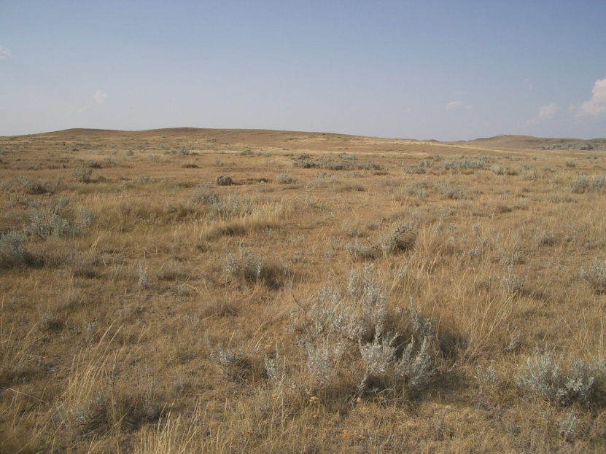
Changes in grassland production
If the climate is drier, the production of forage is lower.
Annual production determines sustainable stocking rates, so it affects the incomes of livestock producers.
A model was developed to predict the changes in production with climate change.
↓

Slide 12
Grassland Production (kg/ha)
– southwest corner of Saskatchewan

Slide 13
Carbon fertilization effect
These models do not account for the fertilizing effect of increasing carbon dioxide concentrations.
Field experiments with CO₂ enrichment chambers show increased grassland production.
But nutrient uptake and forage quality may decline, so cattle would have to eat more.
Overall effect is uncertain, but carbon fertilization may help to offset the effect of a drier climate.

Slide 14
Effects of Extreme Events
These models represent the average climate – what about year-to-year variation?
Some studies indicate that climate change will increase variability in precipitation, resulting in more frequent and more intense droughts.
Extreme wet years can also be bad for livestock operations.
These extreme events could be more important than the changes in average productivity.

Slide 15
Yearly Production at Manyberries, AB, and Effect of Climate Change on Average Production

Slide 16
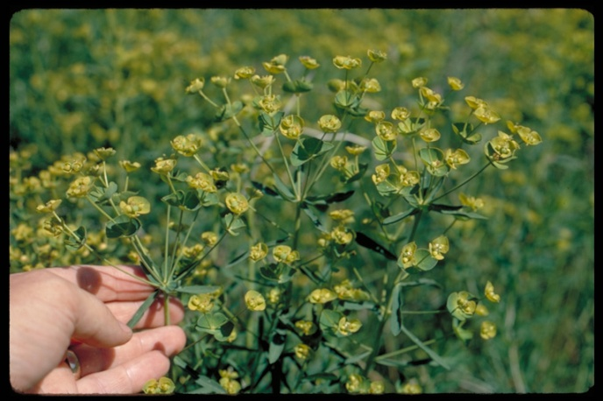
The problem of invasive plants
Invasive species are a major problem in grasslands.
Climate change could be a stress that makes communities more susceptible to invasion.
Invasive species have traits that will make them winners under climate change.
So invasion problems could increase – the first new species to arrive could be invasives.

Slide 17
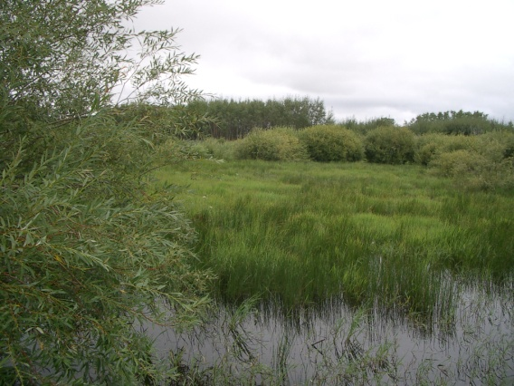
Climate change and wetlands
Weather controls wetlands:
moisture balance→ number of ponds → number of ducks
Models predict decreasing pond numbers and duck populations with climate change.
Interaction with land use: drainage of wetlands exacerbates impact of climate change.

Slide 18
Adaptation options – the three Rs:
Short term – resist the effects of climate change
Medium term – increase resilience, allowing system to return to previous state following disturbance
Long term – help the system to adaptively respond to change rather than resisting it

Slide 19
Short term adaptations – actions of producers to cope with extreme events
Reducing numbers of livestock
Moving livestock to alternative grazing
Purchasing feed
Hauling water

Slide 20
Medium term adaptations – actions by producers and governments to increase the resilience of the system
Changing herd structure – higher proportion of yearlings
Sustainable grazing management to improve rangeland health
Converting marginal cropland to perennial forages
Planning for increased feed reserves
Improving water storage and distribution systems
Community pasture programs
Detection and control of invasive species
Crop insurance and assistance programs
Drought monitoring and prediction tools

Slide 21
Long term adaptations
Predictions of future change are too variable and uncertain for development of long-term prescriptive plans.
Be aware that directional changes may be happening, and have monitoring systems in place so you can detect them and adjust policies accordingly.
In the meantime:
keep grassland systems healthy
don’t reduce your future options (e.g. by eliminating grasslands)
help grasslands to respond to change.

Slide 22
Helping grasslands to respond
Prairie grasslands have a high capacity to respond to climatic variability by shifts in proportions of species.
But eventually new species will have to move northward.
Habitat fragmentation will impede this response.
Conserving as much grassland as possible, and maintaining connections between patches, will facilitate migration.
Grassland fragmentation
(SW Manitoba)

Slide 23
Adaptation progress
Alberta Sustainable Resource Development has led the way in developing an adaptation framework to incorporate climate change into their business areas.
document key vulnerabilities
assess risks
identify adaptation options
develop action plans
PRAC grassland vulnerability work provided technical information for assessing vulnerabilities and risks in ASRD’s rangeland management program.

Slide 24
Progress (continued)
Current work by ASRD on vulnerability of species at risk:
Is climate change incorporated in current species assessment process?
Applicability of adaptation framework in identifying and managing species that are vulnerable to climate change
Comparative review of vulnerability assessment tools applied by other jurisdictions.
Proposed approaches to vulnerability assessment that support and complement existing processes in Alberta.

Slide 25
Progress (continued)
Manitoba Agriculture, Food and Rural Initiatives and Manitoba Conservation are directly engaged with climate change.
Active participation in PRAC work on grassland vulnerability and adaptation options.
Series of workshops:
November 2010 – staff and policy-makers from both MAFRI and MC
November 2011 – MAFRI staff and policy-makers
February 2012 – external stakeholders
Workshops presented information on vulnerability, and engaged participants in identifying policies related to adaptation.

